Slide 1


JSPM’s
Rajarshi Shahu College of Engineering, Tathawade, Pune
(An Autonomous Institute affiliated to Savitribai Phule Pune University)
Department of Computer Science and Business Systems
Academic Year: 2026-27
Project Title: AgriManage – Farm Management System
Students Name and PRN no: Atharva Gogawale (RBT25CB053), Gauree Rajapure (RBT25CB052)
Date: 26-10-2026
Course Name: Database Management System
Course Coordinator: Prof. Rutuja S. Bachhav

Slide 2
Index
Introduction
Problem Definition & Objectives
Literature Survey
Feasibility Study
System Design & Architecture
Database Design & ER Diagram
SQL Implementation & Results
Conclusion
References

Slide 3
Introduction / Background
Definition: AgriManage is a web-based farm management system that stores and connects farm data – farmers, land, soil, crops, inputs, equipment and sales – in one MongoDB database.
Background: Farm records are usually kept in notebooks or scattered spreadsheets, so related data (land ↔ crop ↔ input ↔ sale) is hard to link and search.
Domain context: Agriculture supports a large share of rural livelihoods in India; accurate records drive planning and income.
Motivation: A centralised database gives quick access to data, fewer errors and instant revenue reporting – the core purpose of a DBMS.

Slide 4
Problem Definition & Objectives
Problem Definition
Farm data is maintained manually, causing duplication, no link between land, cultivation, inputs and sales, and no quick revenue view.
Objectives
Design a database for 13 related farm entities with proper relationships.
Build a 2-tier application (HTML/JS client + Express/MongoDB backend) with full CRUD.
Auto-calculate sales totals (quantity × price per unit) and show a live dashboard.
Maintain data integrity using references between collections.

Slide 5
Literature Survey
Manual registers / Excel: simple, but no relationships, high redundancy, error-prone.
Government portals & apps (e.g. e-NAM, Kisan Suvidha): focus on market prices and advisory, not a farmer’s own land-to-sale records.
Generic ERP / farm software: costly and complex for small farms.
Gap identified: no simple, low-cost, integrated system linking farmer, land, soil test, season, crop, inputs, equipment and sales.

Slide 6
Feasibility Study
Technical Feasibility
Node.js, Express and MongoDB are open source, well documented and run on an ordinary laptop (localhost:3000).
Financial / Business
No licence cost; only development time. Tracks sales revenue (₹3,84,000 in sample data) to support profit decisions.
Operational Feasibility
Simple menu-based browser UI with a page per entity; minimal training needed.

Slide 7
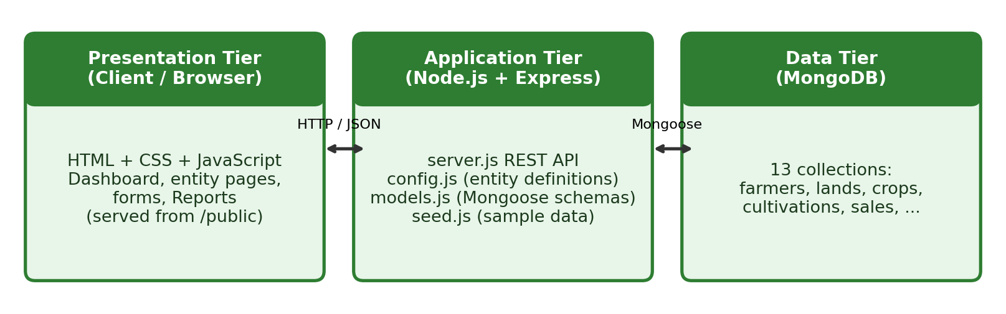
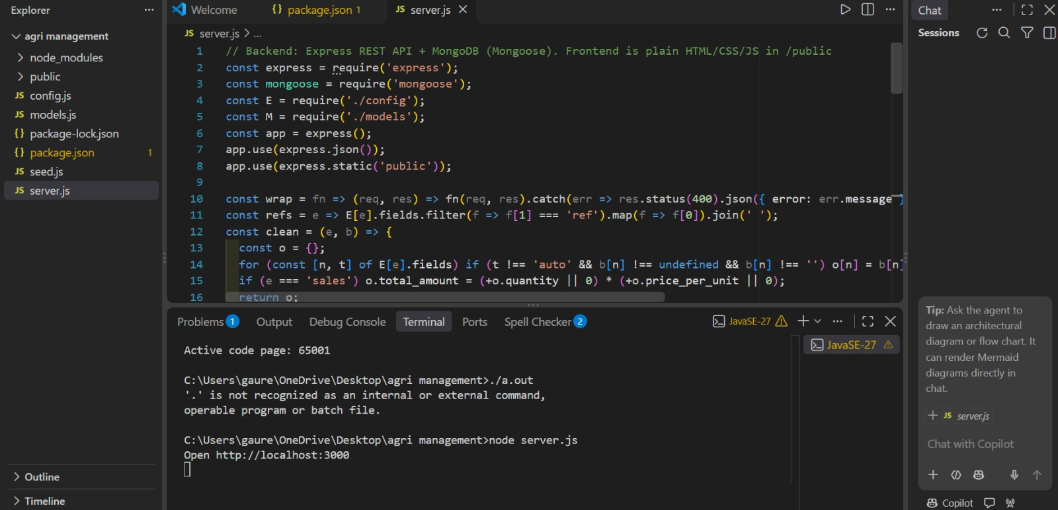
System Design & Architecture
Three-tier flow: Browser (HTML/CSS/JS) → Express REST API → MongoDB via Mongoose.
Generic API: one entity-driven route set; helpers wrap (error handling), refs (reference fields), clean (removes empty/auto fields).
Sales total_amount = quantity × price_per_unit, computed on the server.

Slide 8
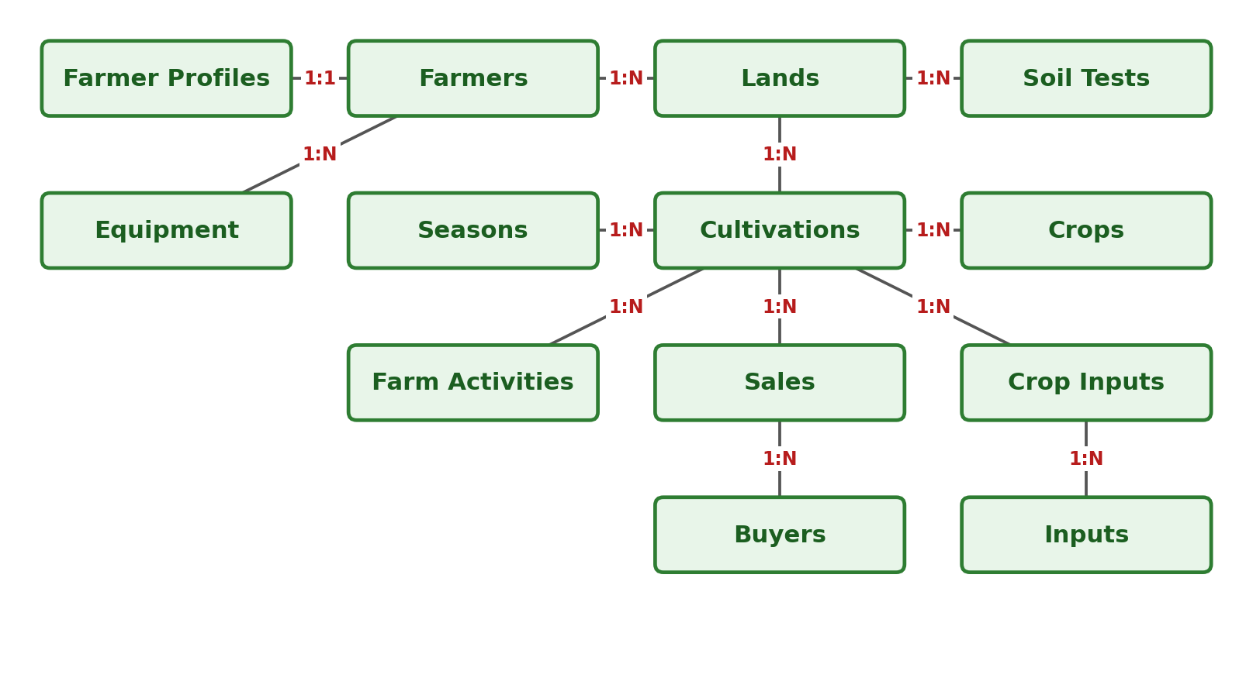
Database Design & ER Diagram
13 collections (+ Reports view)
1:1 – Farmer ↔ Profile
1:N – parent to child
Cultivations links Land, Season and Crop
Sales ← Buyers, Cultivations
Crop Inputs links Cultivations & Inputs

Slide 9
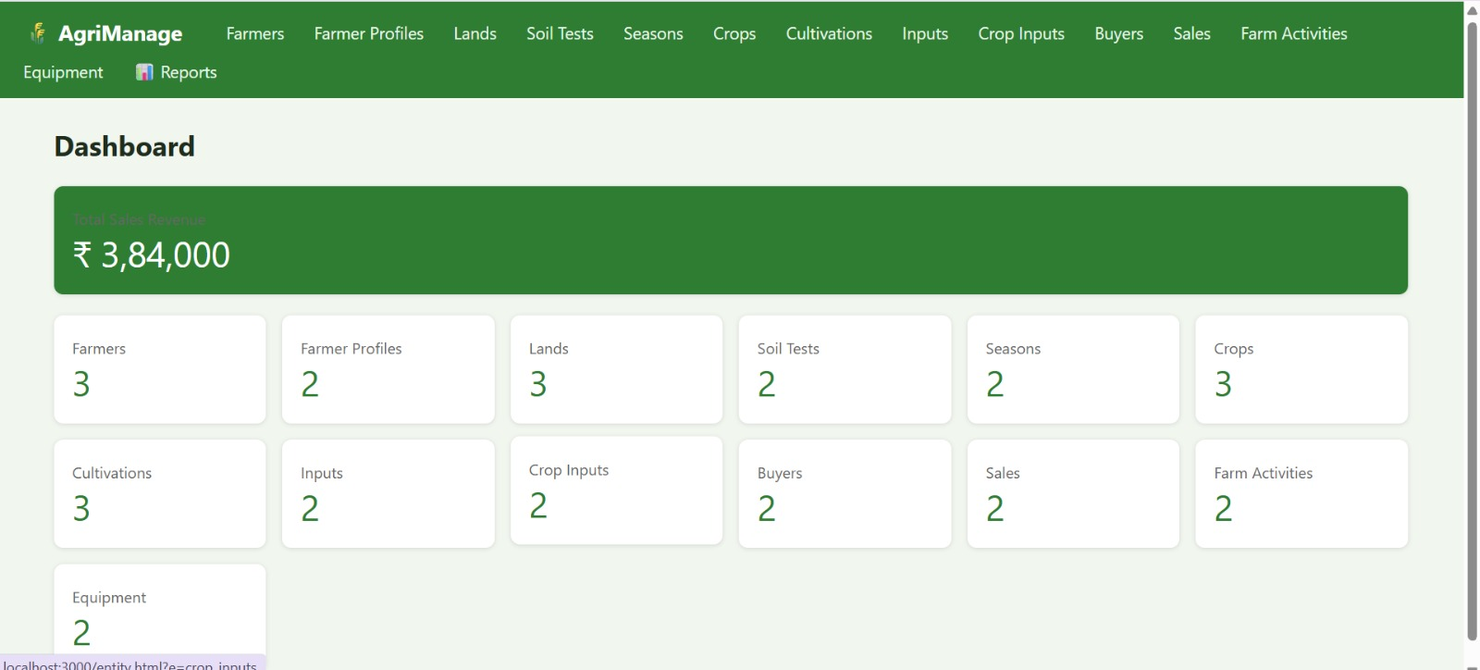
SQL Implementation & Results
MongoDB queries used
db.farmers.find()
db.sales.aggregate([{ $group: {
_id: null,
total: { $sum: "$total_amount" } } }])
db.crops.insertOne({ ... })
db.lands.updateOne({ _id }, { $set: {...} })
db.sales.deleteOne({ _id })
Results
All 13 modules working with full CRUD
Dashboard shows live record counts
Total sales revenue: ₹3,84,000 (auto-calculated)
Fig: AgriManage dashboard (localhost:3000)

Slide 10
Conclusion
AgriManage successfully integrates 13 farm entities into one MongoDB database with a simple web interface.
Meets the objectives: schema design, 2-tier application, CRUD, references and automatic sales total.
Limitations: no login/roles, no charts or export, basic validation.
Future scope: user authentication, charts, PDF/Excel reports, weather & market-price APIs, mobile app.

Slide 11
References
Silberschatz, Korth, Sudarshan – Database System Concepts, McGraw-Hill.
Elmasri & Navathe – Fundamentals of Database Systems, Pearson.
MongoDB Documentation – https://www.mongodb.com/docs/
Express.js Documentation – https://expressjs.com/
Mongoose Documentation – https://mongoosejs.com/docs/
Node.js Documentation – https://nodejs.org/en/docs/
MDN Web Docs (HTML, CSS, JavaScript) – https://developer.mozilla.org/

